Slide 1
CS310 Operating Systems Lecture 11: Thread Abstraction and its implementation
Ravi Mittal
IIT Goa

Slide 2
References
Book: Operating Systems: Principles and Practice: Thomas Anderson and Michael Dahlin, Part 1 and Part 2
CS162, Operating Systems and Systems Programming, University of California, Berkeley
CS4410, Operating Systems, Course, Cornell University, Spring 2019, Lecture on Threads
Operating Systems: Three Easy Pieces, by Remzi and Andrea Arpaci-Dusseau, available for free online
Book: Modern Operating Systems, Andrew Tenenbaum, and Herbert Bos, 4th Edition, Pearson

Slide 3
Read the following:
Book: Operating Systems: Principles and Practice (2nd Edition) Anderson and Dahlin
Volume 2, Concurrency
Chapter 4: Concurrency and Threads
Book: Modern Operating Systems: Tenenbaum and Bos
Chapter 2: Processes and Threads

Slide 4
Concurrency vs Parallelism

Slide 5
Concurrency - concept
Word concurrency refers to multiple activities that can happen at the same time
Analogy: juggling
Real World is concurrent
Your Mother’s activities
Role of secretary, etc

Slide 6
Concurrency Vs Parallelism
We can combine both concurrency and parallelism

Slide 7
Smart phones are concurrent
Mobile Phones
Do many tasks simultaneously on multiple processors
Hundreds of tasks go on in a mobile phone at any time
Receiving signals
Sending Signals
Running battery checking routine
Running music application
Running Browsers
Mobile Management task
Security related tasks
Running Internet Stack
Running Interface applications

Slide 8
Today’s applications – inherently concurrent
Most applications today have user interfaces - that demand good responsiveness to users, while
Simultaneous executing application logic
Simultaneous support for a large number of users
Example:
Amazon.com
Online Banking applications
Self Driving cars’
For a programmer
It is easy to think sequentially
Complex to plan, design, develop system that have thousands of tasks running concurrently and parallelly

Slide 9
Thread Abstraction

Slide 10
Recall: Thread Concept
A single-execution stream of instructions that represents a separately schedulable task
Single execution Sequence: Each thread executes a sequence of instructions – just as in the sequential programming model
Separately schedulable task: OS can run, suspend, resume a thread at any time
Bound to a process: lives in an address space
Each thread is very much like a separate process, except for one difference: they share the same address space and thus can access the same data
Finite Progress Axiom: execution proceeds at some unspecified, non-zero speed

Slide 11
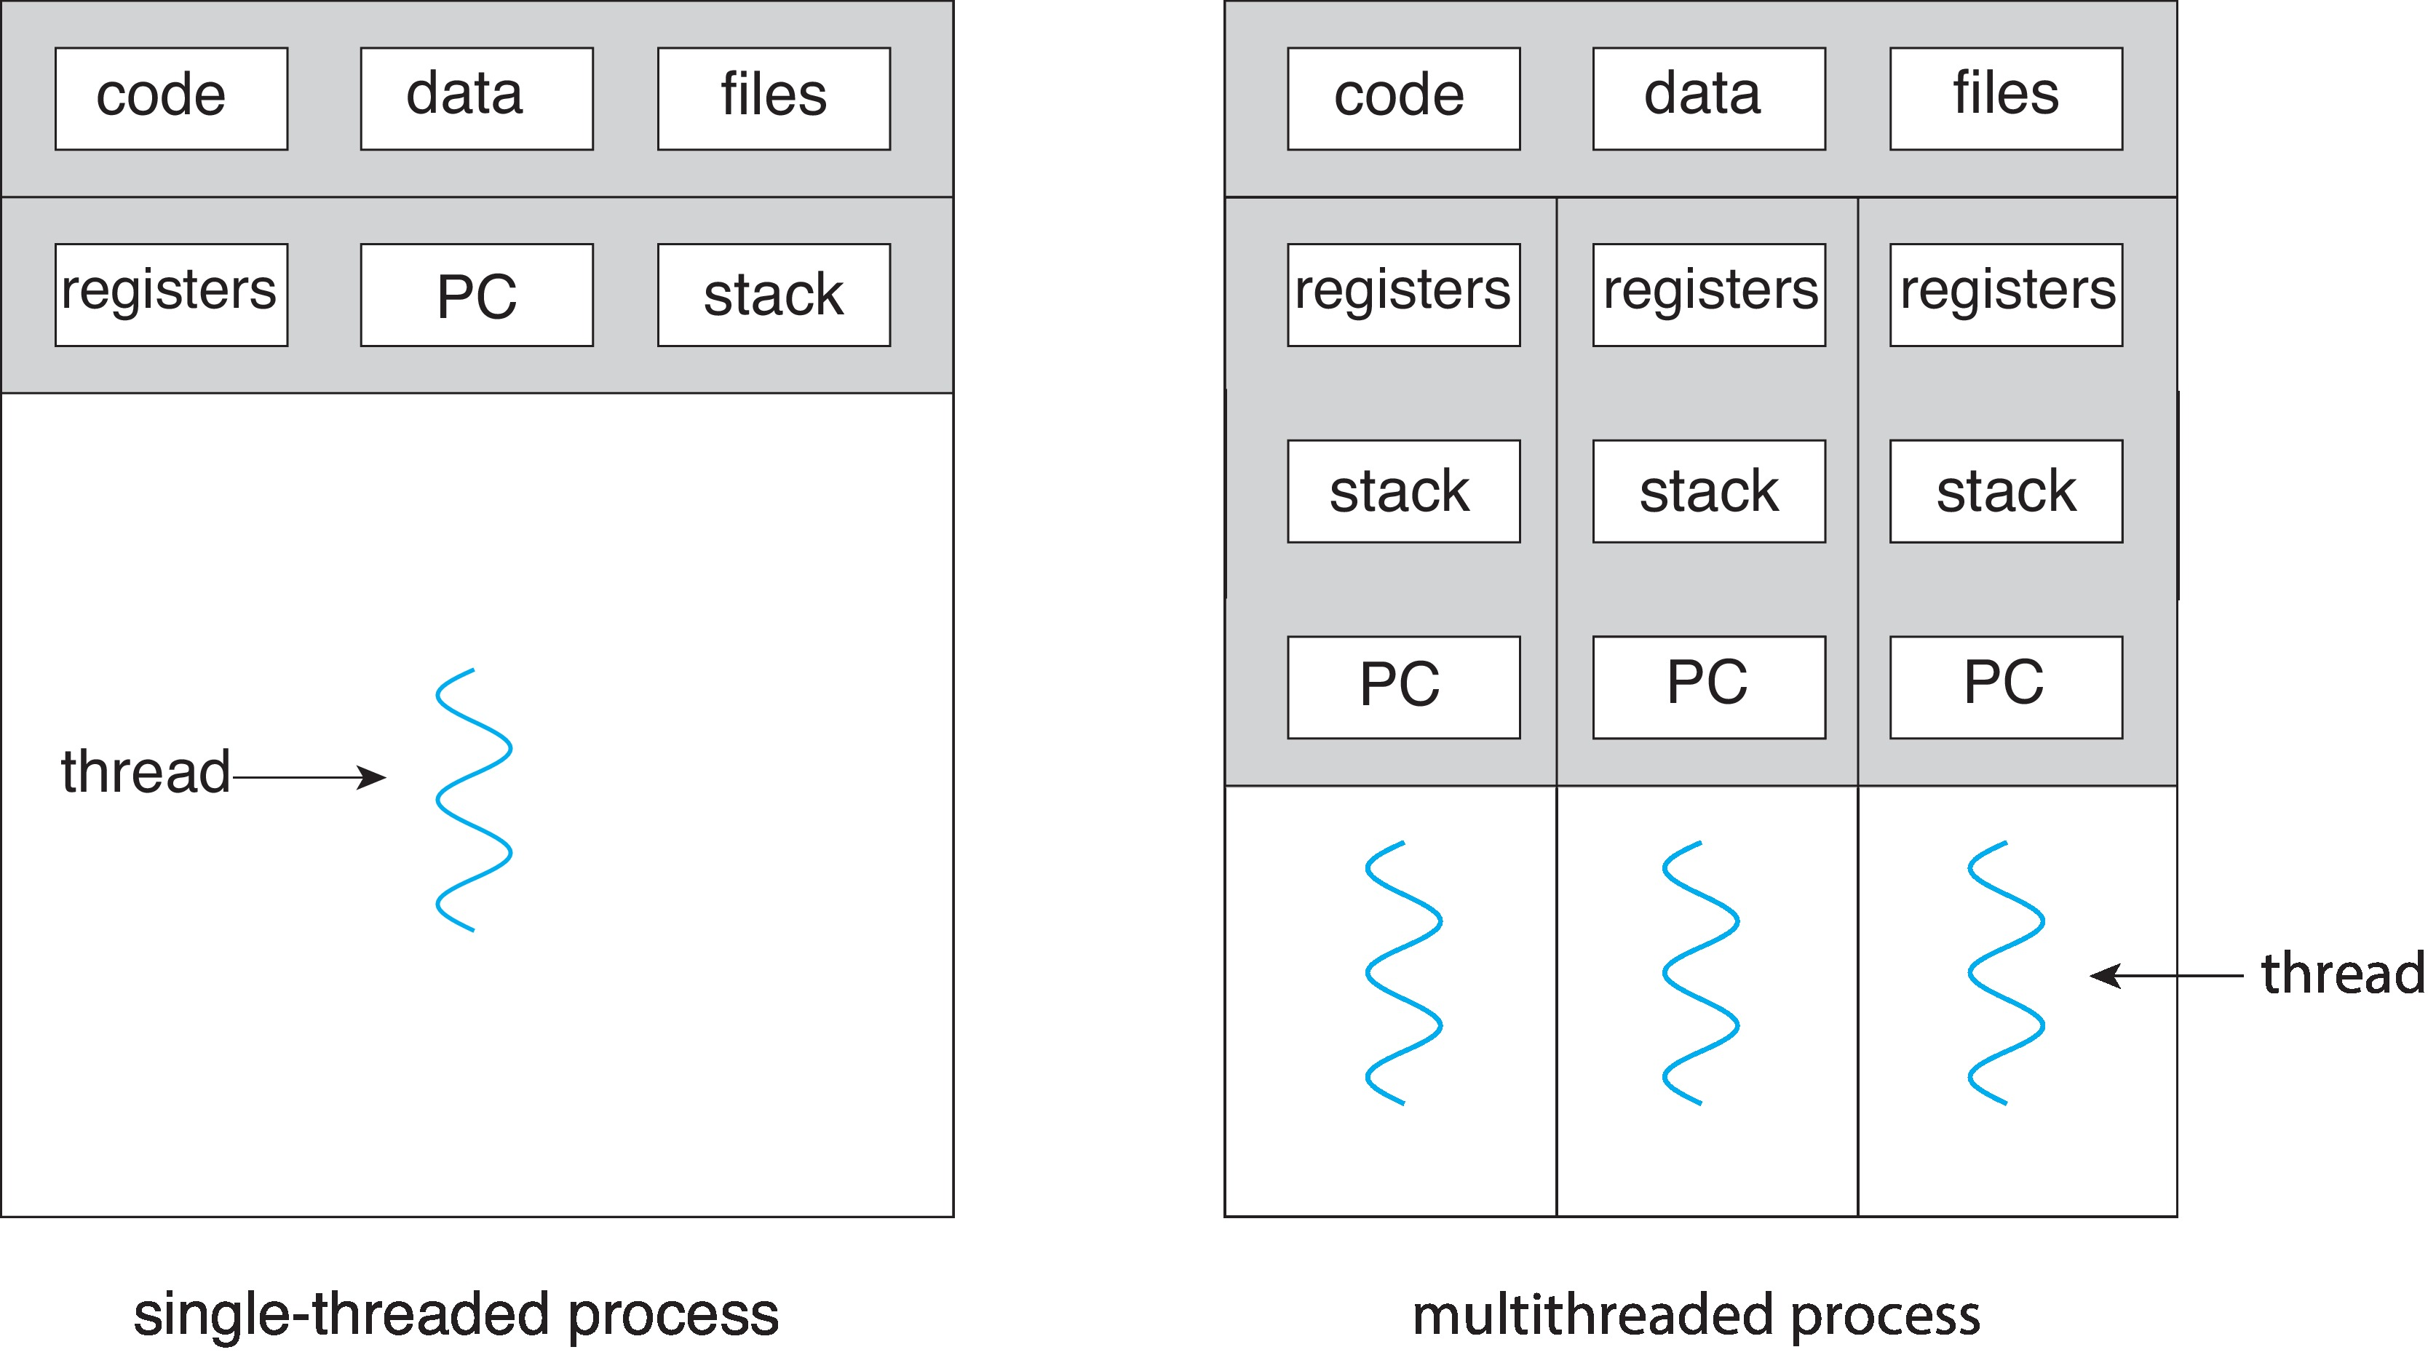
Recall: Single and Multithreaded Processes
Address
Space
Address spaces encapsulate protection: Passive Part
Threads share code, data, files, heap

Slide 12
Recall: Thread - basics
A scheduler may context switch a thread and bring in another thread for execution
Each thread appears to be a single stream of execution
Programmer needs to pay attention only to the sequence of instructions within a thread and not whether or when that sequence may be suspended to let another thread run
Main thread is the initial thread of every process
This is basically Main()
Every additional thread for some function
Example: for I/O operation
For network data receiving

Slide 13
Thread Abstraction
It helps programmers to create as many threads as needed
Without worrying about number of processors in a system
OS provides illusion of a very large (nearly infinite) number of virtual processors
OS manages the illusion by transparently
Suspending and resuming threads so that at a given time a subset of threads are actively running

Slide 14
Thread Abstraction

Slide 15
Thread – a basic element to support concurrency
How to write a concurrent program – with so many activities?
Think it as a set of sequential stream of execution – or threads
That interact and share results in very precise ways
With threads we can define a set of tasks that run concurrently while code for each task is sequential
Operating Systems Principles and Practice: Anderson and Dahlin

Slide 16
Possible Executions
Prof. John Kubiatowicz, CS 162, Operating Systems, UCB

Slide 17
Programmer vs. Processor View
Single Thread’s Execution
Prof. John Kubiatowicz, CS 162, Operating Systems, UCB

Slide 18
Programmer vs. Processor View
Single Thread’s Execution
Prof. John Kubiatowicz, CS 162, Operating Systems, UCB

Slide 19
Programmer vs. Processor View
Single Thread’s Execution
Prof. John Kubiatowicz, CS 162, Operating Systems, UCB

Slide 20
Example 1: Word Processor
Example: A writing book consisting of a number of chapters
Good to keep all chapters in a single file for ease of operations ; say total 800 pages
Consider
User deletes a sentence in Page # 1. Now, user wants to make change in page no 600 and gives command to go there
Word processor is now forced to reformat all pages (at least up to page no 600)
If there is a single process to do all tasks – User may face delays
Solution: two threaded program – one interacts with the user another handles reformatting; The second thread starts work as soon as the user deletes the line on page 1
How about addition of the third thread for auto saving?
Adapted from Tenenbaum’s book: Modern Operating Systems

Slide 21
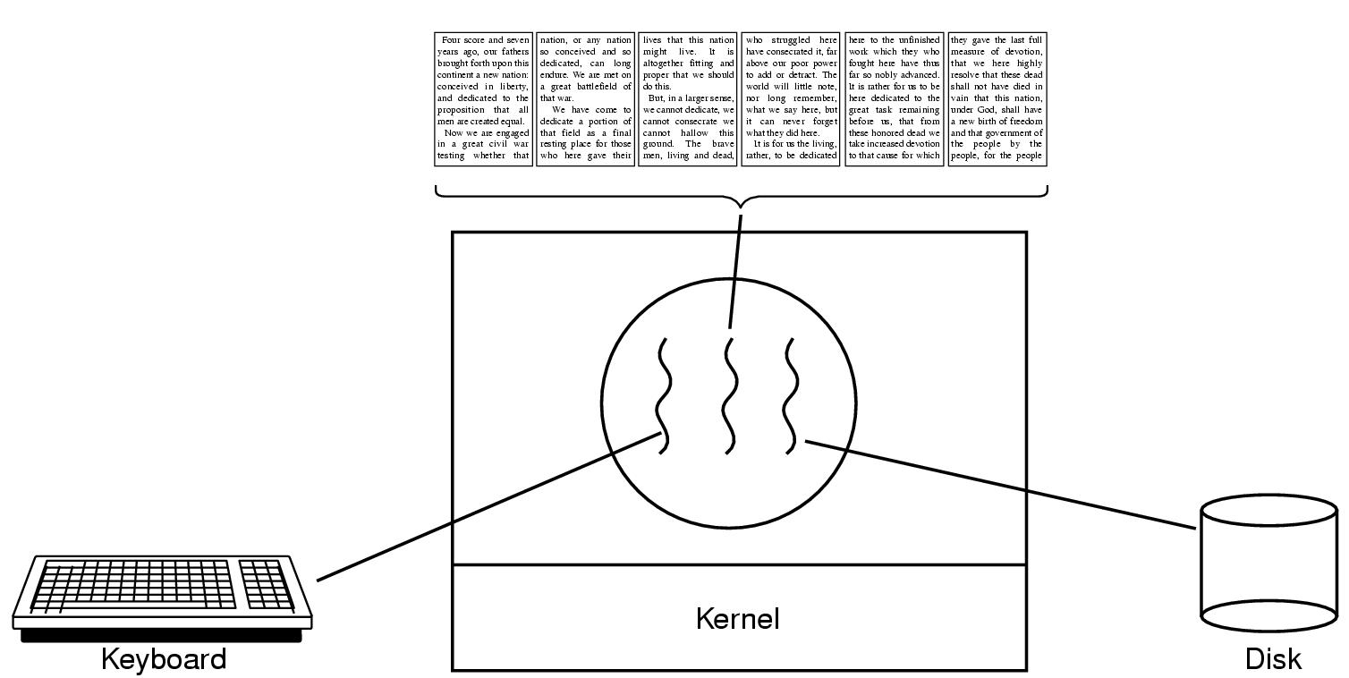
Example 1: Word Processor
A word processor with three threads
If the program were single threaded
Whenever a disk backup started, command from keyboard and mouse would be ignored unless backup completed
Adapted from Tenenbaum’s book: Modern Operating Systems

Slide 22
Example 1 Word Processor
The 1st thread works on user interaction
The 2nd thread works on formatting document when it is told to do so
The 3rd thread writes the contents of RAM to disk periodically (auto save feature)
Note that all 3 thread work on common document – they share a common memory – all have access to the document being edited
Three processes instead of thread will complicate the task
Adapted from Tenenbaum’s book: Modern Operating Systems

Slide 23
Example 2: Processing of a large amount of data
Normal approach:
Read in a block of data
Modify it
Write it back
The process will use block system call at read and write operation
CPU will go idle
Better Approach:
Processes can be structured as input thread, processing thread and an output thread
Input thread: reads data into input buffer
Processing thread: takes data from input buffer, processes data and puts the results in an output buffer
Output thread: Writes buffer data to the disk
The soln works if syscall blocks only calling thread not the entire process
Adapted from Tenenbaum’s book: Modern Operating Systems

Slide 24
Example 3: A multithreaded web server (1)
Page request from clients – page is sent back
Web page cache – collection of heavily used pages in MM
Dispatcher Thread
reads incoming request for work from network
Chooses an idle (blocked) worker thread and handover the request and make it into ready state
Worker thread: When scheduled, worker thread checks if the page is available in webpage cache
If yes, deliver it to another process for sending it over the network
If not, get the page from disk ; block till it gets the page from disk
Both dispatcher and worker threads operate in infinite loop
Adapted from Tenenbaum’s book: Modern Operating Systems

Slide 25
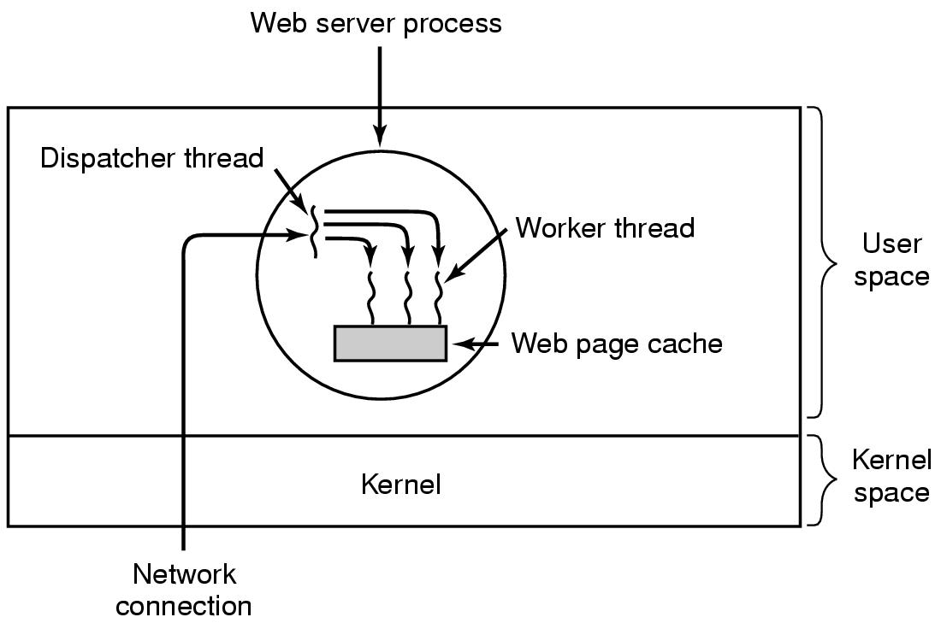
Example 3: A multithreaded web server (2)
Adapted from Tenenbaum’s book: Modern Operating Systems

Slide 26
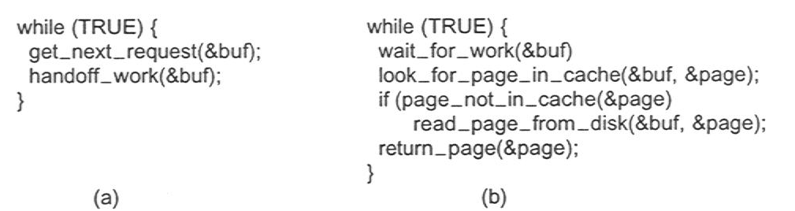
Example 3: A multithreaded web server (3)
Dispatcher thread
Worker thread
Adapted from Tenenbaum’s book: Modern Operating Systems

Slide 27
Recall: Why Threads?
To express a natural program structure
Updating the screen, fetching new data, receiving user input — different tasks within the same address space
To exploit multiple processors
Different threads may be mapped to distinct processors
To maintain responsiveness
Splitting commands, spawn threads to do work in the background
To mask long latency of I/O devices
Do useful work while waiting
Instead of waiting, the program may do something else
CPU can perform other computation, or
Threads are the natural way to avoid getting stuck
Why not processes instead of threads?
Threads are light weight: Share data and address space
Processes are sound choice when using logically separate tasks
CS4410 Cornell University

Slide 28
Why Threads?
Threads are lighter weight than processes
Easier to create and destroy than processes
Creating thread is 10-100 times faster than creating a process
Specially when the number of threads needed changes rapidly and dynamically,
Parallel programs must parallelize for performance
Programs with user interface need threading to ensure responsiveness
Network and disk bound programs use threading to hide network/disk latency
A multithreaded program is a generalization of the same basic programming model
Each individual thread follows a single sequence of steps (eg loops, call/return from functions, conditions etc)
A program can have several such threads in execution at the same time

Slide 29
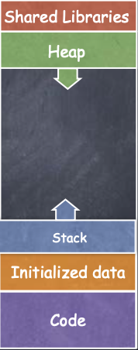
Recall: Thread
Process Address Space
All threads within a process share
Heap
Global/static data
Libraries
Each thread has a separate
Program Counter
Stack
registers
Any stack-allocated variables, parameters, re- turn values, and other things that we put on the stack
CS4410 Cornell University

Slide 30
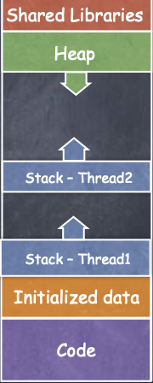
Recall: Threads
Process Address Space
All threads within a process share
Heap
Global/static data
Libraries
Each thread has a separate
Program Counter
Stack
registers
CS4410 Cornell University

Slide 31
Suspension and termination
Suspending a process involves suspending all threads of the process since all threads share the same address space
Termination of a process, terminates all threads within the process

Slide 32
Memory Footprint: Two-Threads
If we stopped this program and examined it with a debugger, we would see
Two sets of CPU registers
Two sets of Stacks
Questions:
How do we position stacks relative to each other?
What maximum size should we choose for the stacks?
What happens if threads violate this?
How might you catch violations?
Stack 1
Stack 2
Address Space
Heap
Global Data
Code
Prof. John Kubiatowicz, CS 162, Operating Systems, UCB

Slide 33
Lecture Summary
Thread is single unique execution context
Program counter, registers, stack
Registers hold the root state of the thread: PC, Gen Regs
Rest of the thread’s state is in memory
Threads naturally implement concurrency
A Process consists of more or more threads
Threads are light weight
Processes are more strongly isolated than threads

